Slide 1
Implementation of Video Salient Object Detection via Fully Convolutional Networks
Paper Details:
Title: Video Salient Object Detection via Fully Convolutional Networks Author: Wenguan Wang, Jianbing Shen and Ling Shao
Publication YEAR: FEBRUARY 2017
Presented by: Nitika Aggarwal, Karan bhatiya

Slide 2
CONTENts
Problem Statement
Proposed Solution
Implementation Details
Results
References

Slide 3
Problem Statement
What is salient object
Salient object detection is an essential step in many image analysis tasks as it not only identifies relevant parts of a visual scene but may also lessen computational complexity by filtering out immaterial segments of the scene.
Need of Salient Object Detection?

Slide 4
Proposed Solution / Implementation
Two Major Steps:
Static Saliency
Dynamic Saliency

Slide 5
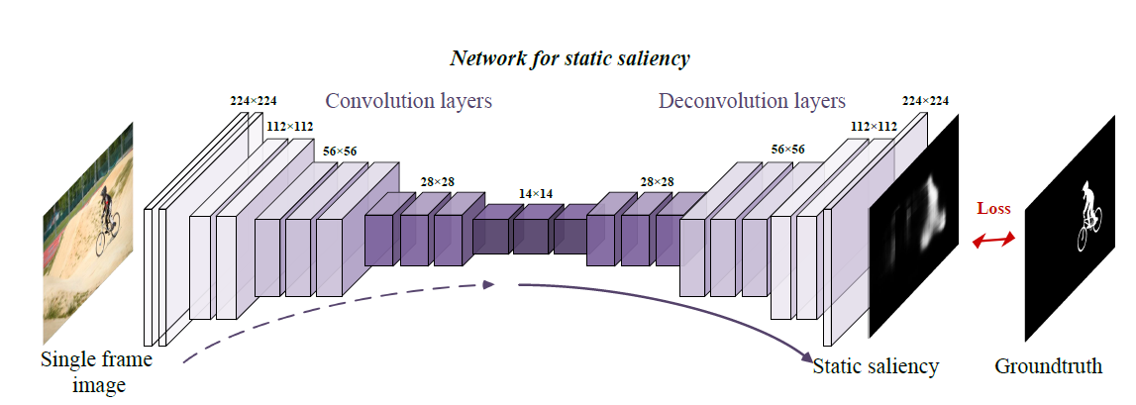
Static Saliency

Slide 6
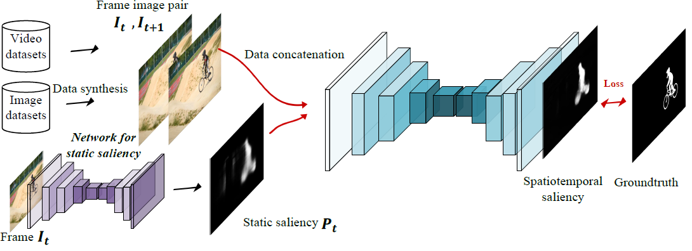
Dynamic Saliency

Slide 7
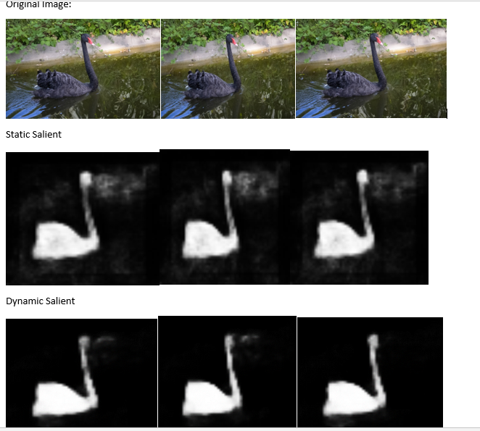
Results

Slide 8
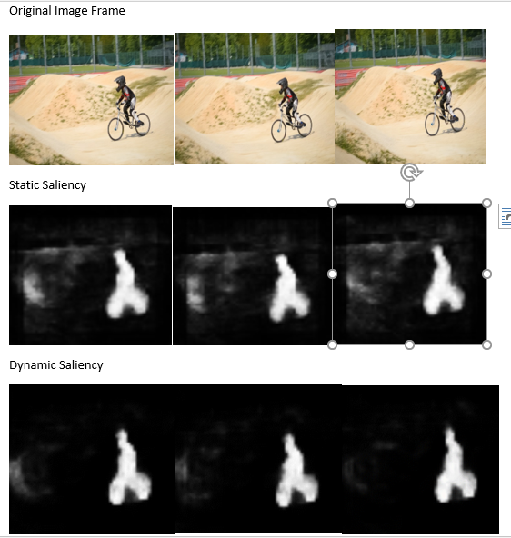
Results

Slide 9
REFErences
https://arxiv.org/pdf/1702.00871.pdf
https://arxiv.org/pdf/1409.1556.pdf
https://davischallenge.org/
https://keras.io/models/model/
https://www.pyimagesearch.com/2018/07/16/opencv-saliency-detection/
https://lmb.informatik.unifreiburg.de/resources/datasets/moseg.en.html

Slide 10
Thank you!!
Questions?

